Slide 1


HISENSE
An AI Interview System

Slide 2

Team Members
Manoj Neupane
Bishwash Singh
Backend Developer
Frontend Developer
Sneha Malla Thakuri
Bimala Adhikari
UI/UX Designer
UI/UX Designer

Slide 3

Agenda
01
Introduction
04
Tech Stack
02
Problem of Statement
05
System Workflow
03
Featured Solution
06
Demo

Slide 4


Introduction
We developed the AI Interview System to make hiring faster, smarter, and fairer.
Ensures unbiased evaluation for fair hiring decisions.
Provides a smoother, more efficient, and transparent experience for both employers and candidates.

Slide 5
Agenda
01
Introduction
04
Tech Stack
02
Problem of Statement
05
System Workflow
03
Featured Solution
06
Demo

Slide 6

Problem of Statement
Manual CV Shortlisting
Human Bias
Accessibility
Interview Scheduling Hassle

Slide 7
Agenda
01
Introduction
04
Tech Stack
02
Problem of Statement
05
System Workflow
03
Featured Solution
06
Demo

Slide 8
Featured Solution
Automated CV Shortlisting
Smart Interview Scheduling
Accessibility for Local Organizations
Instant Scoring & Feedback
Future Expansion

Slide 9
Agenda
01
Introduction
04
Tech Stack
02
Problem of Statement
05
System Workflow
03
Featured Solution
06
Demo

Slide 10
Tech Stack
Frontend (User Interface): react
Backend (Server & Logic): node.js
Database: MongoDB (to store resumes, results, job posts, candidate data)
AI components: Gemini

Slide 11
Agenda
01
Introduction
04
Tech Stack
02
Problem of Statement
05
System Workflow
03
Featured Solution
06
Demo

Slide 12
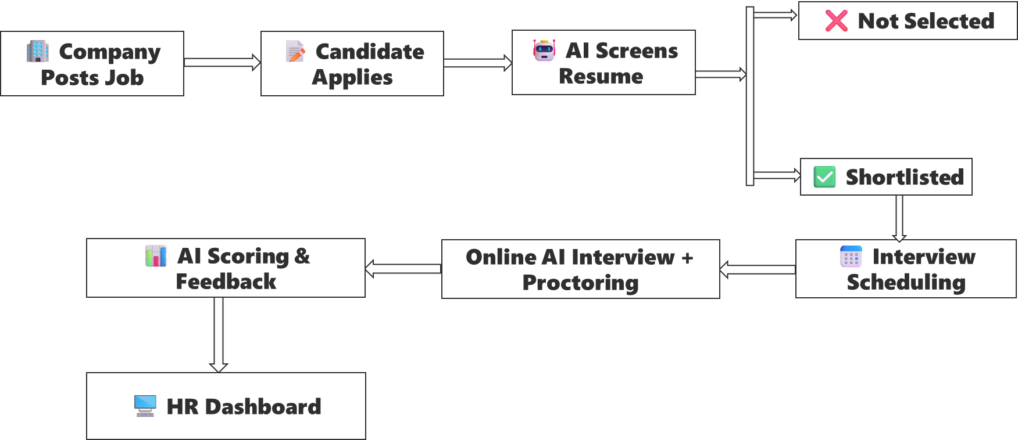
System Workflow

Slide 13
Agenda
01
Introduction
04
Tech Stack
02
Problem of Statement
05
System Workflow
03
Featured Solution
06
Demo

Slide 14
Demo

Slide 15
THANKS!

